Slide 1
Decision Analysis (DA) Prep
mm/dd/yyyy - Steve Mortimer, XXXXXXXXXXX, XXXXXXXX

Slide 2
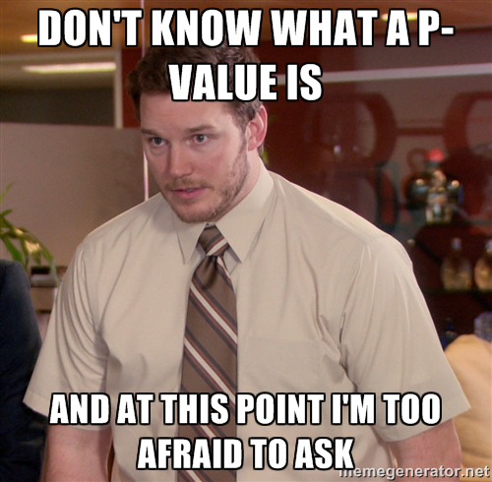
The Purpose or Goal
What do we hope to accomplish?
Give you some statistics basics
Introduce the core DA concepts,
but slower & more background
Answer any questions/concerns
We are not here to give you
“the answers” to the DA courses!
Source: Wikipedia

Slide 3
Agenda
The items we’re covering
Distributions
Statistical Tests
Regression
Decision (Logic) Trees

Slide 4
What is a Distribution?
Consider flipping a coin
A distribution shows the number times each possible outcome will occur relative to one another

Slide 5
What is a Distribution?
Consider rolling a die
Why all the
way to 100%?
Distributions cover ALL possible outcomes so they always sum to 100%

Slide 6
Continuous vs. Discrete Distributions
Classifying different types of distributions
Discrete
A finite (countable) number of possible outcomes
Continuous
An infinite* number of possible outcomes
* Typically something that is a number and has many possible values even if we are able to count every possible value
https://www2.census.gov/library/publications/2010/compendia/statab/130ed/tables/11s0205.pdf

Slide 7

This is so boring.
What does this have to do with DA?!

Slide 8
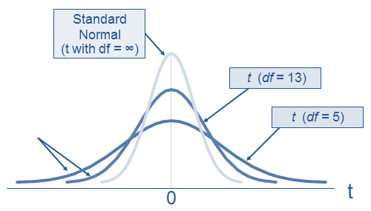
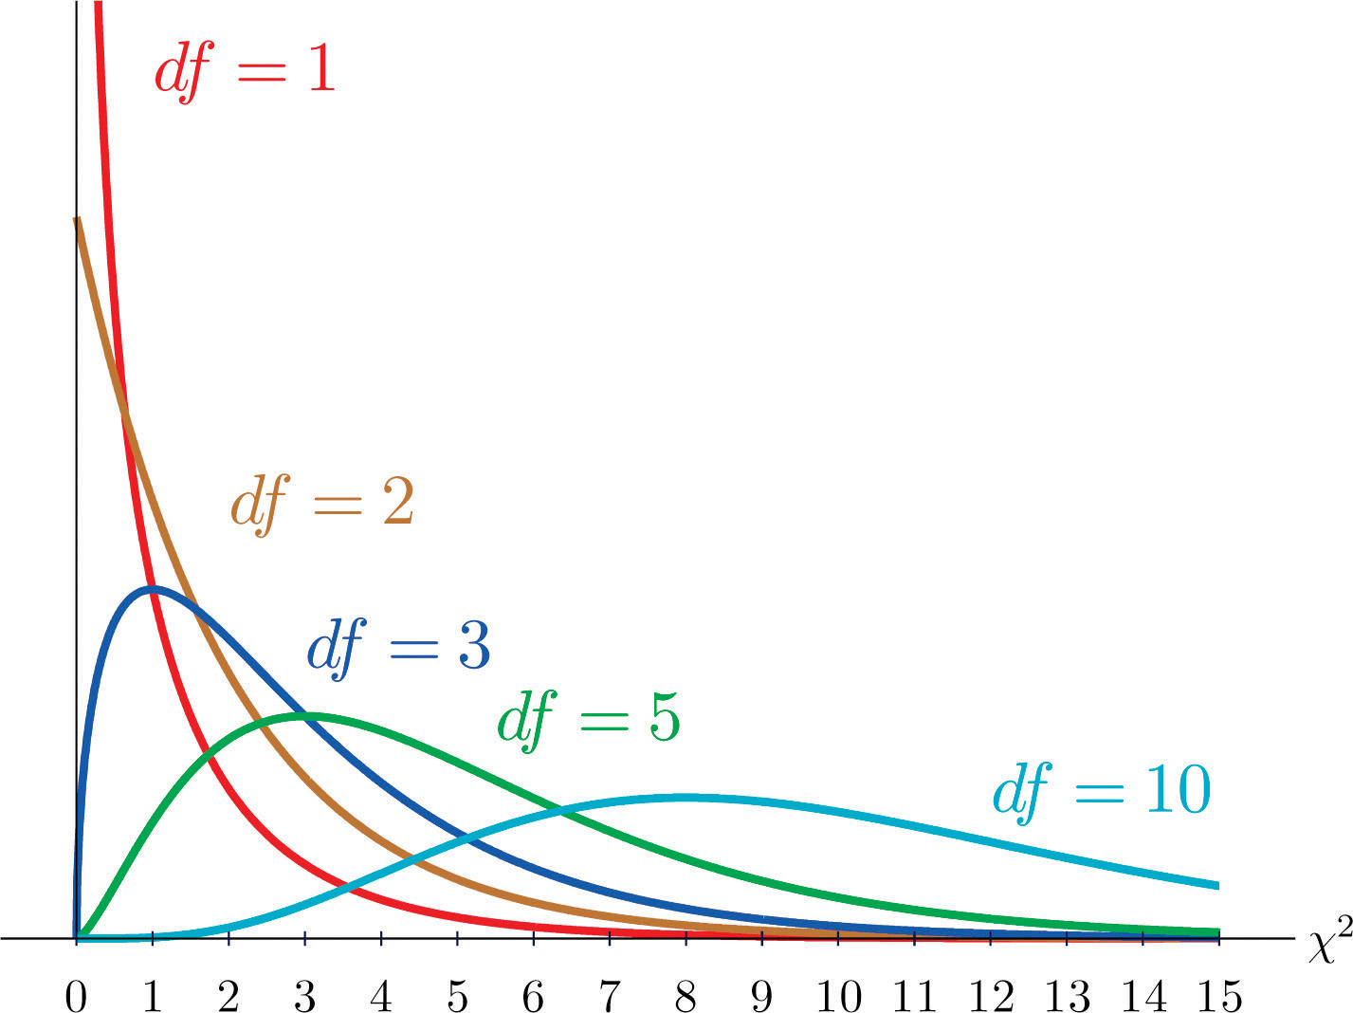
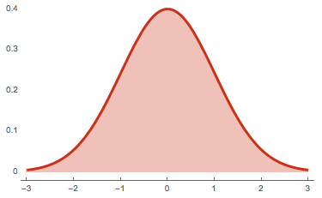
The Distributions You Need to Know
Defined by their shape
Normal (“Z”)
Student’s T (“T”)
Chi-Squared (𝜒²)
Summary:
“Bell shaped”
Symmetric (same on both sides)
Defined by mean (center) and variance (spread)
Summary:
A little wider than Normal dist.
Also symmetric
Defined by the degrees of freedom
Summary:
”Long tailed”
Not symmetric
Also defined by its degrees of freedom

Slide 9
Agenda
The items we’re covering
Distributions
Statistical Tests
Regression
Decision (Logic) Trees

Slide 10
You Can’t Do Statistical Tests Without Distributions!
Matching the distributions to statistical tests
Normal (“Z”)
Student’s T (“T”)
Chi-Squared (𝜒²)
One Sample Test (“Z-test”)
Two Sample Test (”T-test”)
Test of Independence & Goodness of Fit
Is our one sample different from what we expect?
Are our two samples different from each other?
Are two variables independent of each other
– OR –
Is the distribution a close fit to another distribution?

Slide 11
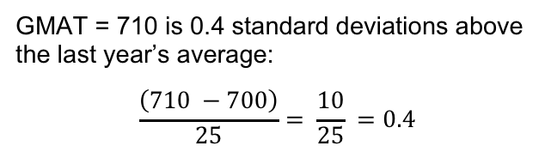
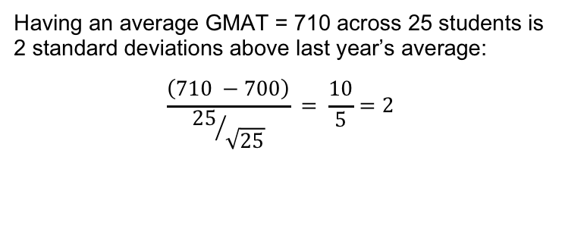
One Sample Test with Normal Distribution
Are Darden students’ GMAT scores higher than last year’s students’ scores?
Last year the average was 700. We are told that GMAT scores have a standard deviation = 25.
1 Student: 710 GMAT
GMAT = 710 is 0.4 standard deviations above the last year’s average:
$$\frac{\left(710 −700\right)}{25}= \frac{10}{25} =0.4$$
25 Students: 710 GMAT
Having an average GMAT = 710 across 25 students is 2 standard deviations above last year’s average:
$$\frac{\left(710 −700\right)}{{25}/{\sqrt{25}}} = \frac{10}{5}=2$$
WHAT HAPPENED HERE?!?

Slide 12

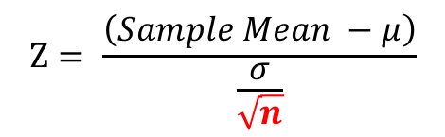
The Central Limit Theorem
More observations in a sample shrinks the std. dev. of the average
Test Statistic (“Z”)
$$Ζ= \frac{\left(Sample Mean −μ\right)}{\frac{σ}{\sqrt{n}}}$$
https://vimeo.com/75089338

Slide 13
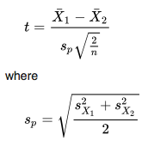
Two Sample Test (“T”)
How to draw a comparison if both groups are samples
Scenario:
We randomly sampled 25 students from Class of 2019 and found – GMAT Avg: 700, Std. Dev: 15
We sampled 25 students from Class of 2020 and found – GMAT Avg: 710, Std. Dev: 10
We use the data to create a statistic with a distribution we know and see where it falls!

Slide 14
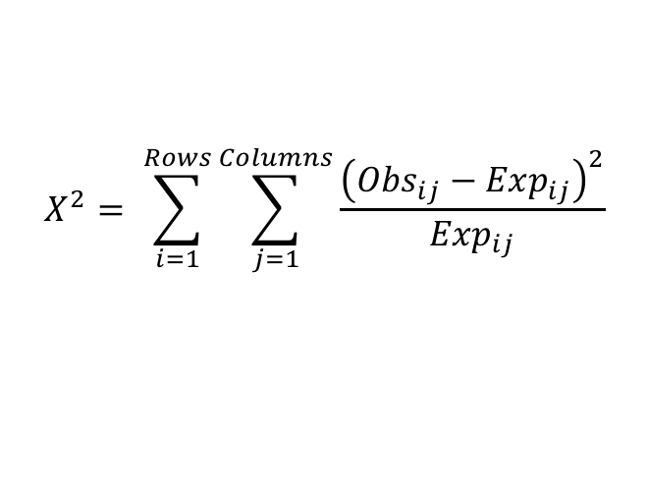
Chi-Squared Test (“𝜒²”)
Comparing Counts of Data
Counts of things are always zero or more (positive) so there’s a different distribution for positive data
Test Statistic (𝜒²)
$$Χ^{2}= \sum_{i=1}^{Rows}{\sum_{j=1}^{Columns}{\frac{{\left({Obs}_{ij}−{Exp}_{ij}\right)}^{2}}{{Exp}_{ij}}}}$$

Slide 15
The Area Under the Distribution
How to get the area using only Excel
Normal (“Z”)
Student’s T (“T”)
Chi-Squared (𝜒²)
GMAT One Sample Example:
1 – NORMSDIST(2) = 0.023
GMAT Two Sample Example:
1 – TDIST(2.7735 ,48) = 0.004
Smoking/Cancer Example:
CHIDIST(5.4, 1) = 0.02
Statistical Tests are Easy! Decide on the statistic you want to use, then figure out area under curve

Slide 16
Agenda
The items we’re covering
Distributions
Statistical Tests
Regression
Decision (Logic) Trees

Slide 17
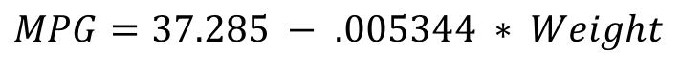
Linear Regression
Fit a line between points
$$MPG=37.285 − .005344 ∗ Weight$$
What if a car weights 3,000lbs? What would the MPG be?
$$37.285 − .005344 ∗3000=21.25mpg$$
“Intercept” (where line crosses if Weight is zero)
“Coefficient” (slope or change that every pound of weight affects the MPG)

Slide 18
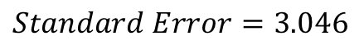
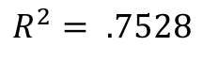
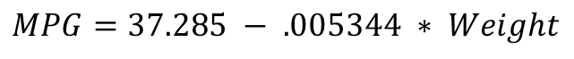
Validating Your Regression Model
It involves more than just fitting a line
Is Weight significantly related to MPG? Or is it a fluke?
Coefficients are distributed based on the T-distribution, so we can do a statistical test on them to see if significant!
$$T=−9.56→p=0.000000000129$$
When my model is wrong (residual), is it always wrong in the same way (systematic error)?
$$MPG=37.285 − .005344 ∗ Weight$$
$$R^{2}= .7528$$
$$Standard Error=3.046$$

Slide 19
Agenda
The items we’re covering
Distributions
Statistical Tests
Regression
Decision (Logic) Trees

Slide 20
Modeling Real-Life Outcomes
Using a Decision (Logic) Tree to assess the possibilities
Club Meeting?
Food?
Pizza?
Good Pizza
900 cals
Prob = 14%
Pizza
Prob = 25%
Go
Prob = 70%
Bad Pizza
600 cals
Prob = 42%
Prob = 80%
Prob = 75%
Dinner Calories
Sandwiches
500 cals
Prob = 24%
Prob = 30%
Cook
500 cals
Prob = 1%
Not Go
Prob = 5%
Prob = 20%
Eat Out
800 cals
Prob = 19%
Prob = 95%

Slide 21
Decision (Logic) Tree Outputs
Shows us the range of outcomes and expected
Expected (Avg.) = 655

Slide 22
Questions?
In Person: Ask Now!
DSC Email: DataScienceClub@darden.virginia.edu
Steve Mortimer: MortimerS19@darden.virginia.edu

